Slide 1

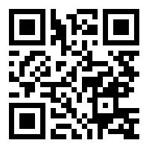
Duck Workshop
https://bit.ly/2JQGDr3

Slide 2

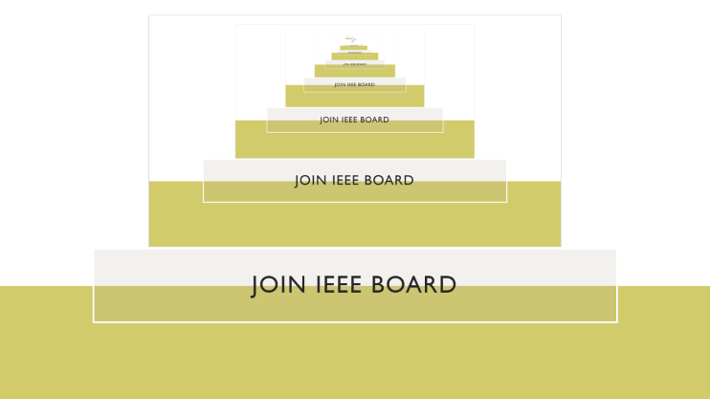
Join IEEE Board

Slide 3
What We’re doing
Timers
Overview
Solder
Build a duck

Slide 4
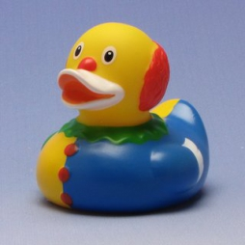
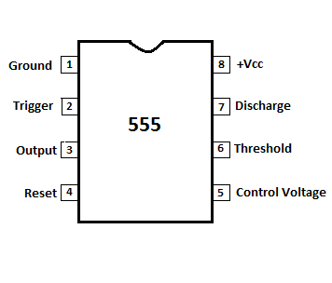
Hecking 555 timers. How do they work?
Three modes of operation:
Astable mode – Works like a clock
Monostable mode – Generates single pulses, PWM
Bistable mode – Works similar to a flip-flop
Operate between 5 and 18 Volts
CMOS versions run at lower voltages >2v
This workshop uses a CMOS 555 timer (TLC555)

Slide 5
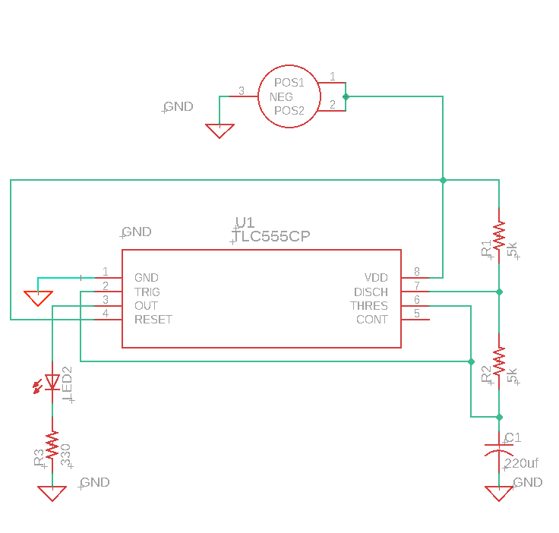
The circuit: Astable Mode
t_{on} ≈ 0.69*C1*(R1+R2)
t_{off} ≈ 0.69*C1*R2
t_{on} ≈ 1.5484 Sec
t_{off} ≈ 0.7742 Sec

Slide 6
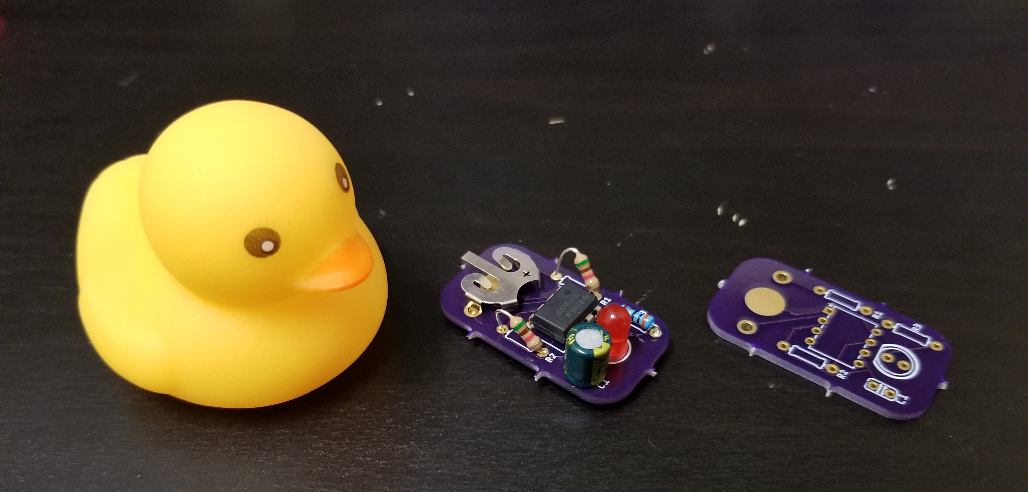
Build a duck

Slide 7
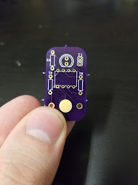
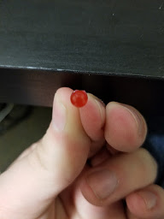
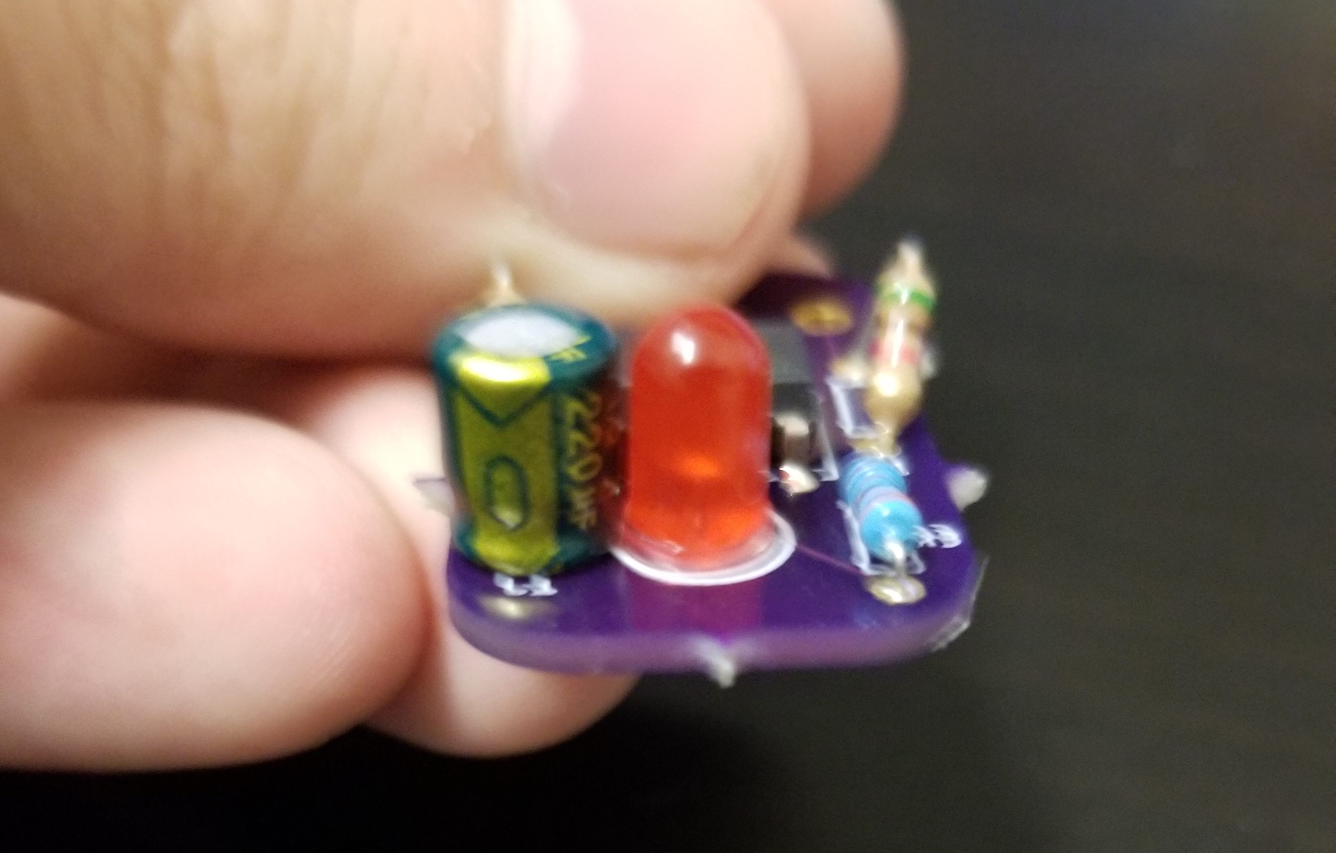
First components: LED and Capacitor
Flat part of LED matches with PCB
Negative stripe should be pointed to “C1” label as show

Slide 8
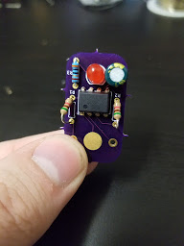
Resistors
330 Ω blue resistor (R3) goes next to LED
5.1K Ω tan resistors (R1 & R2) go on the sides
Tan resistors won’t quite fit. Angle them up (see example board)

Slide 9
555 timer
Bend pins in so they can fit in the holes
Make sure the circle shown in the photo matches your 555 timer. That’s a position indicator.

Slide 10
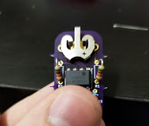
Battery holder
Pop into two holes.
Make sure orientation matches picture

Slide 11
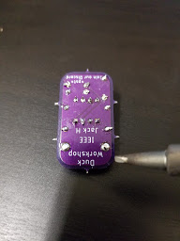
Soldering
Solder from side shown
Snip excess wire

Slide 12
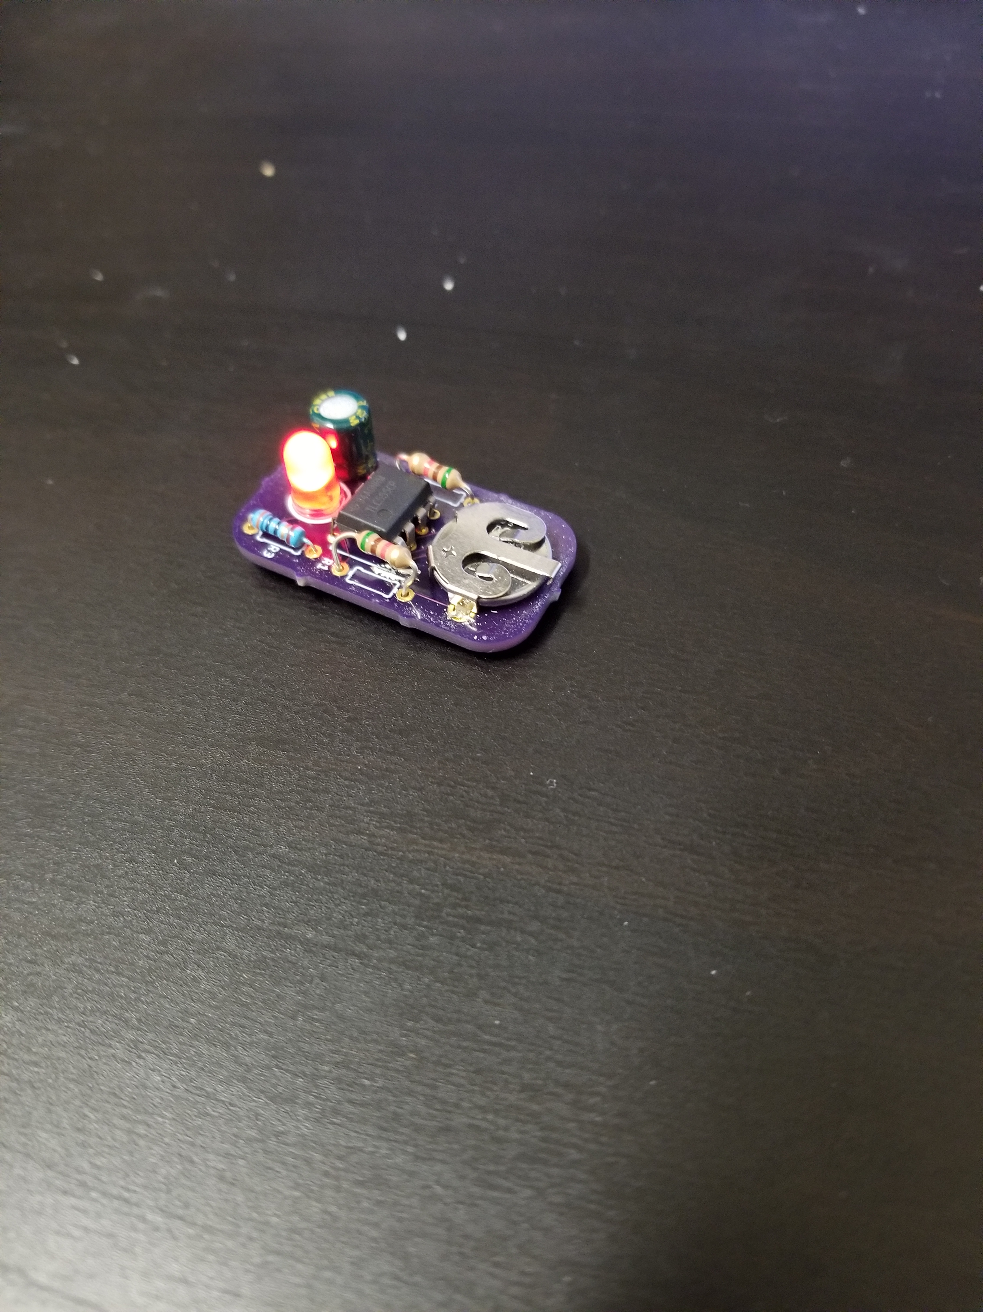
Test
Insert battery.
Does it flash?

Slide 13
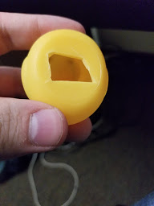
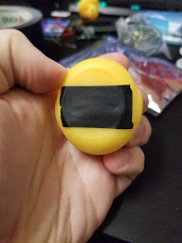
Inserting into duck
Make sure LED and capacitor are in/around the duck’s head
Seal hole with electrical tape

Slide 14
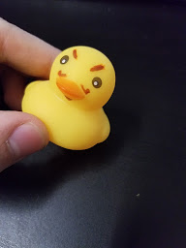
Decorate duck!

